Slide 1


SSIS
Presented by,
Arunagiri
Anjali
Neha Singh
Sushmitha S

Slide 2
WHAT WE ARE GOING TO PRESENT
ARUNAGIRI – EXPLAINATION OF SSIS, DATA INTEGRATION, ADVANTAGES AND DISADVANTAGES
1
NEHA SINGH – DATA CONVERSION AND PRACTICAL TASK ON IT
2
ANJALI – FILE SYSTEM TASK
3
SUSMITHA – SLOWLY CHANGEING DIMENSION
4

Slide 3

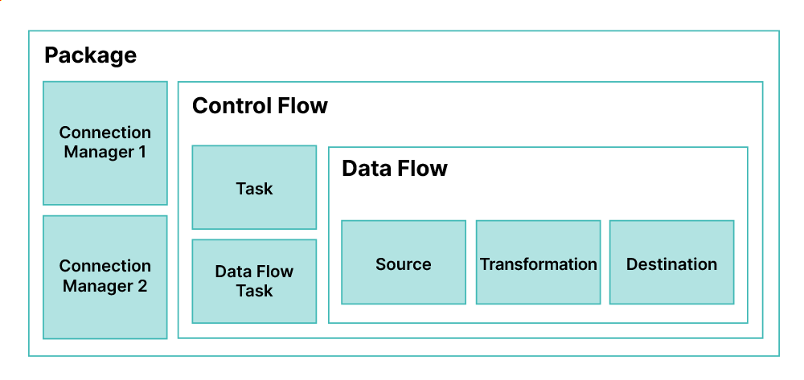
SSIS
What, Why, When, Who, How

Slide 4
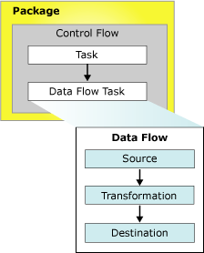
Integration Services (SSIS) Packages AND CONTROL FLOW

Slide 5
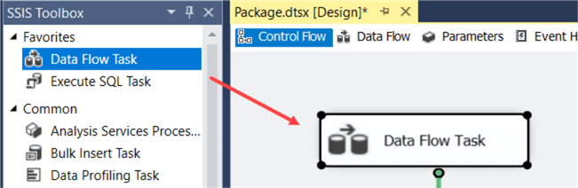
DATA FLOW

Slide 6
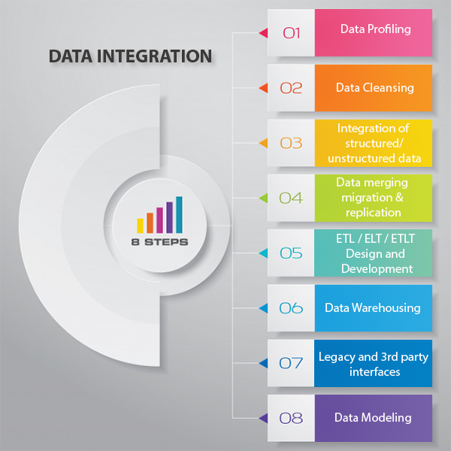

Slide 7
Advantages
Merge data
Coordinating data.
Identifying, capturing, and processing data changes.
Data Loading and Automation.
Standardize data
Building BI.
Time efficient.

Slide 8
Disadvantages
Heavily dependent on SQL Server.
The packages can fail if the database is down.
Integration with third-party services is flaky.

Slide 9

THANK YOU

